Slide 1
Cloud Services 2
Amazon Web Services

Slide 2


FinOps
aka Cost Monitoring Tools

Slide 3



Cloud is critical to every business but is a fundamentally different consumption model...
Decentralized
Variable
Scalable
Engineers siloed from Finance (and Procurement) are empowered to commit the company to spend
Variable cloud spend replacing data center/fixed cost spend, including numerous ways to optimize rates
Instant access to a variety of resources enables innovation but often results in overprovisioning
Use of this work requires attribution to the FinOps Foundation under the ccby4.0 license
Notes:
Cloud is critical to success by bringing The new cloud economy has us facing some new realities in the IT world:
Traditional procurement silos have broken down, buying is decentralized, and it’s only getting more so
Cloud adoption, once the purview of CTOs and the location of science-fair projects now represents MATERIAL and substantial costs for many companies, and it’s only growing
What you buy in the cloud is variable, it changes month to month, day to day, minute to minute. It’s not predictable, and it’s hard to forecast well using traditional methods. And with over 1M Cloud SKUs out there, it’s only getting more complex.
In a cloud world of vast supply, plentiful options and few constraints on your spending, inefficiency is inevitable. But all businesses must focus on efficiency, and need the information to create it. Further, macroeconomic pressures – elections, Brexit, and the coming economic downturn (eventually there will be one) – require even more ruthless efficiency measures.
Inefficiency becomes a target on IT’s back (very important) in a downturn.
Luckily, there’s also a new operating model for the cloud to help address these realities.

Slide 4
Cloud FinOps is an evolving cloud financial management discipline and cultural practice that:
enables organizations to get maximum business value
FinOps is not shorthand for “Financial Operations”. It is a portmanteau of “Finance” and “(Dev)Ops”, stressing the communications and collaboration between business and engineering teams.
by helping engineering, finance, and business teams
to collaborate on data-driven spending decisions
Use of this work requires attribution to the FinOps Foundation under the ccby4.0 license

Slide 5
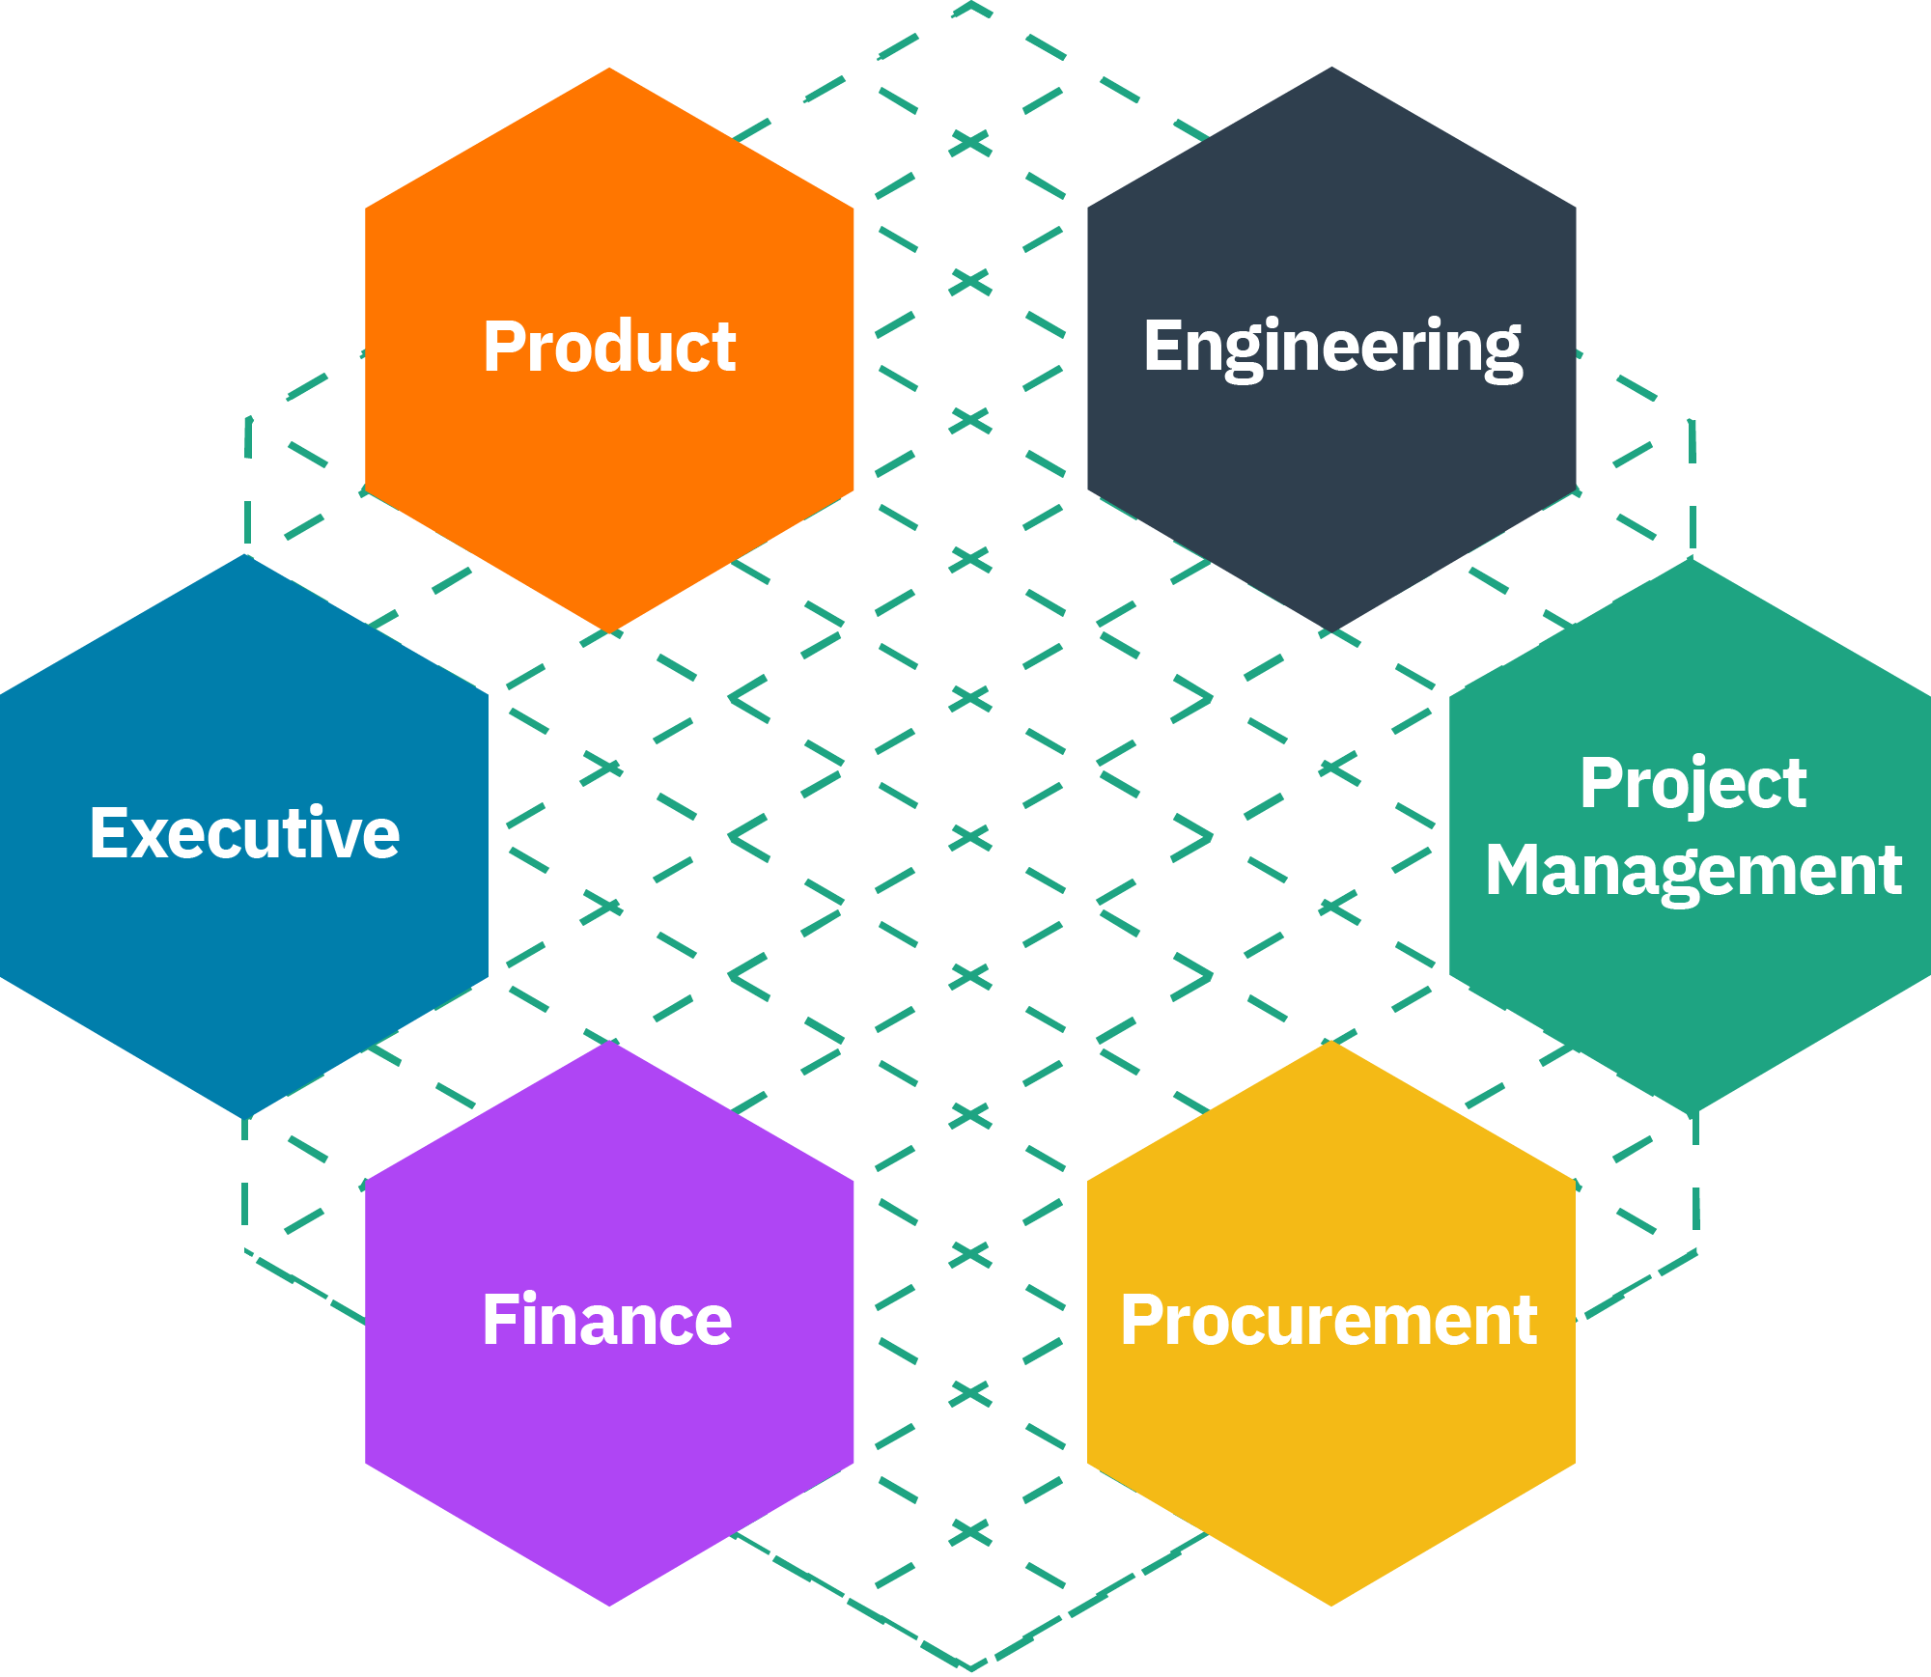

Who does FinOps?
In the same way that everyone is responsible for security with a central team enabling best practices (at scale), many roles do FinOps with help from a central team.
“If I do my job properly I do not need to be in the room when Finance and DevOps teams meet. They are enabled by the work I have done to normalize the cloud bill, allocate and highlight key data points. When FinOps succeeds the business is using the data of FinOps to make better decisions on its own.
Mike Fuller, CTO FinOps Foundation, Former Head of FinOps at Atlassian
Finance
Executives
Procurement
Engineering
Product
Notes:
Before I begin there is one thing that really needs to be kept in mind, FinOps is not done by the FinOps team. Where it makes sense to have a dedicated FinOps team—which we will cover below—that team drives the FinOps activities within an organization. FinOps is a portmanteau of Finance and DevOps to highlight that the goal is for these two teams to work together. I would often say:
““If I do my job properly as a FinOps Practitioner, I do not need to be in the room when Finance and DevOps teams meet. They are enabled by the work I have done to normalize the cloud bill, allocate and highlight key data points. When FinOps succeeds the business is doing FinOps.”
If security if Job 0, then FinOps is Job 0.5.
In the same way that everyone does security with a central team enabling best practices (at scale), everyone does FinOps with help from a central team.

Slide 6
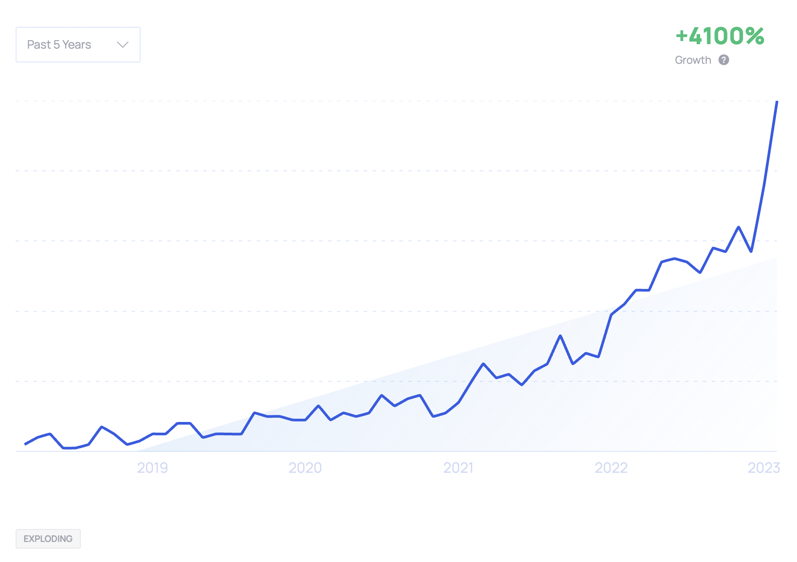

Search Growth
Career Growth
Searches & trending of “FinOps”
People listing “FinOps” as a skill
Notes:
FinOps as a discipline has exploded over the last 5 years, as evidenced by the explosive growth of the search term itself.
When revisiting the first edition of the Cloud FinOps book, we noticed how much it used an us vs. them tone when it came to FinOps teams vs engineering teams. Some of the phrasing indicated that engineers were somehow outside of the work of FinOps and that they didn’t generally care about cost. This is far from the truth in companies who are mature in their cloud—and FinOps—transformation. Unengaged engineers who only do reactive cost optimization merely reflects an immature practice and maturity, where inefficiencies are left to occur and the FinOps process is limited to cleaning up the waste. Instead, mature practices partner with engineers on service design in order to avoid inefficiencies in the way services are deployed on cloud

Slide 7
Team growth comes with cloud spend and complexity
(Figures are stated annual cloud spend, all data from the 2023 State of FinOps)
of those who manage less than $1M do not have a formal FinOps person or team
The responsibility in these situations falls into an existing role, of which 68% lived within Engineering, DevOps or IT
62%
Average team sizes by amount of cloud spend
$1-10M
$10-100M
$100M-500M
$500M-$1B+
2
4
7
10
Notes:
Teams don’t really start until material spend is happening, Who is looking after the spend at the small size - typically it is engineers
When do orgs have a dedicated FinOps team or person
Sizes of dedicated folks in comparison to spend and is also normally a sign of complexity
It is worth pointing out teams can be made up in different ways, ona recent virtual summit we shared how contractors and consultants are in the mix also. Check out the previous recording or the website for those details.

Slide 8

Common Formulas for FinOps Tooling Stack
4.1
Respondents use an average of
FinOps tools
97%
65%
26%
16%
Native Tool
(E.g. AWS Budgets, Azure Cost Management, GCP Intelligent Recommendations)
+
Platform
(E.g. Cloud-*, Homegrown,
Data Lake)
Observability
(E.g. Datadog, New Relic)
Specialist Tool
(E.g. ProsperOps, Kubecost, Spot, Analytics Tools)
+
+
Resource Utilization & Efficiency
Managing Commitment Based Discounts
Forecasting
Managing Anomalies
Workload Management & Automation
Managing Shared Cost
Budget Management
Chargeback & Finance Integration
Measuring Unit Costs
Notes:
In addition to the growing FinOps team size, the State of FinOps 2023 saw an increase in the number of FinOps tools organizations are using as well (up from 3.7 in 2022 to 4.1 on average)
Organizations are using “stacks” of multiple tools to get their FinOps job done
This further illustrates the assertion that there is no one tool that does all of the FinOps jobs different organizations need
While 97% of organizations are using native tools provided by the cloud providers themselves, the more widespread use of multi-cloud and hybrid leads many (65%) to use purchased or home-built platforms to aggregate data and support more complex organizational needs
The wider spread use of containers and the need to support more complex chargeback and optimized savings rates is also leading to more companies using Observability tools for FinOps, and Specialty tools which support a specific FinOps function.
Each of these types of tools are supporting the FinOps Capabilities shown

Slide 9
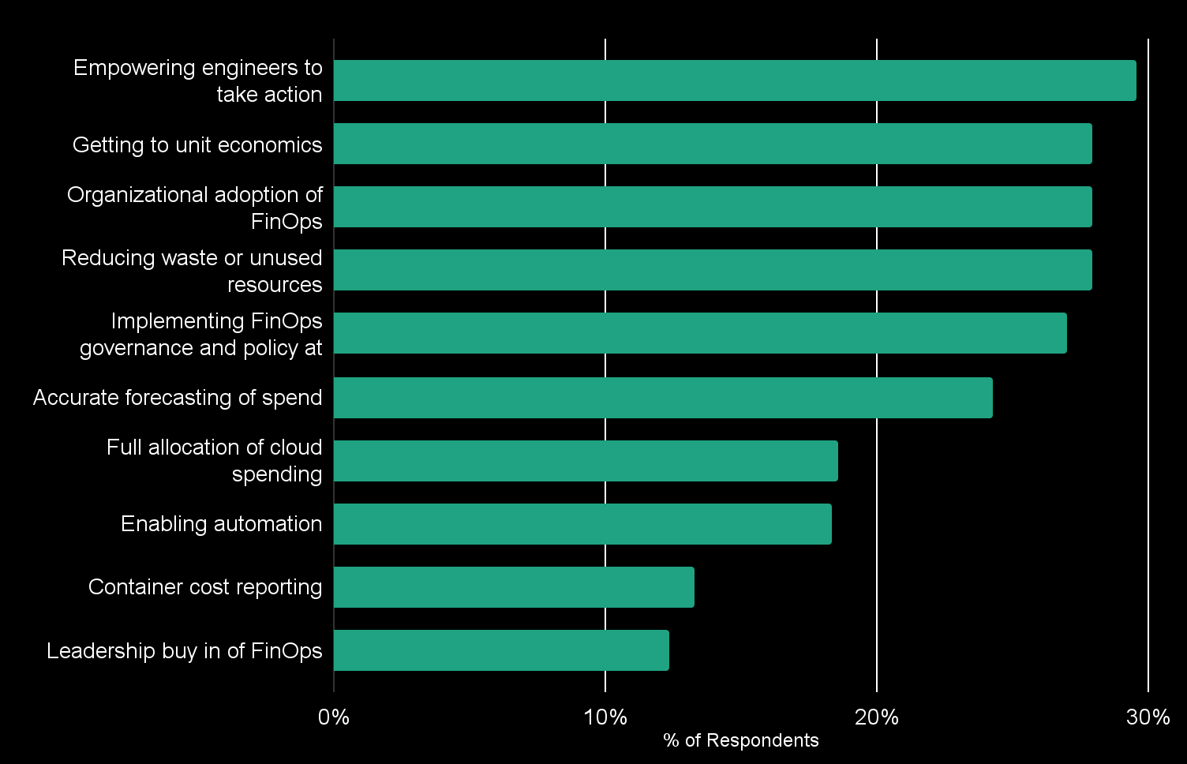
Top Pain Points for FinOps Practitioners (Arrows represent % directional change vs 2022, multi-select answers)
BY CLOUD SPEND
$100M+
Implementing FinOps governance and policy at scale (38.7%)
$10-100M Getting to unit economics & Reducing waste or unused resources (both 33%)
$0-10M Organizational adoption of FinOps (36.8%)
• Empowering Engineers to take action stayed stable as top spot • Unit economics new option tied #2 spot with #3/4 • 30% growth Reducing waste came up considerably • 17% drop in forecasting • 15% increase in container cost challenge
Notes:
One of the main areas of the survey are the top challenges which are a lot closer than previously (2022 had a 10% gap from 2-5 in 2022) this year it is less than 1% gap.
Empowering Eng to take action - stayed stable as top spot
Unit economics: new option tied to #2 spot tied with #3/4.
30% growth Reducing waste came up considerably
17% drop in forecasting
15% increase in container cost challenge

Slide 10


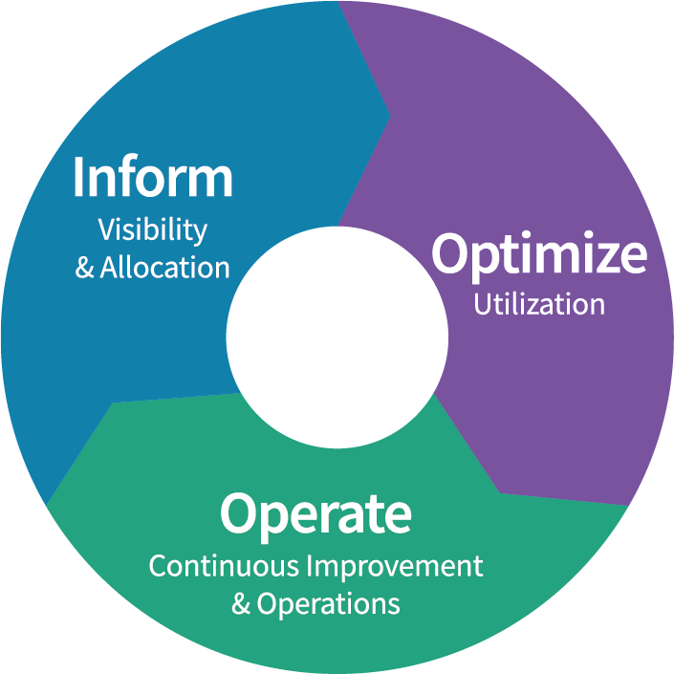





FinOps
Framework
Use of this work requires attribution to the FinOps Foundation under the cc by 4.0 license
Definitions
Maturity
FinOps is an evolving cloud financial management discipline and cultural practice that enables organizations to get maximum business value by helping engineering, finance & business teams to collaborate on data-driven spending decision
Principles
Personas
Crawl
Walk
Run
Phases
Teams need to collaborate
Everyone takes ownership for their cloud usage
A centralized team enables FinOps
Reports should be accessible and timely
Decisions are driven by business value of cloud
Take advantage of the variable cost model of the cloud
FinOps Practitioner
Engineering/Operations
Rates
& Usage
Business/Product Owner
Finance/Procurement
Executives
Domains & Capabilities
Understanding Cloud Usage and Cost
Performance Tracking & Benchmarking
Real-Time Decision Making
Cloud Rate Optimization
Cloud Usage Optimization
Organizational Alignment
Notes:
The FinOps Framework describes the
Principles that drive our FinOps practice%s
The Personas that FinOps must support as stakeholders
The best practices and process models that allow us to accomplish this
And the Domains of activity we will have to perform in our FinOps practice
We use a Looping, flywheel lifecycle for FinOps, seeking to
Inform
Identify Optimization targets
Operationalize those changes
In a flywheel approach that starts off slow and takes a “Crawl, Walk, Run” maturity approach to solving the challenges Cloud introduces to an organization.
You May have heard the Framework called the FinOps Capability Model, or the FinOps Function model previously.
Updated beginning in Fall 2021, will continue to be modified as time goes on, but is largely stable as of January 2022.
FinOps practitioners will perform activities in each of these domains as they build a FinOps team and drive the cultural change that FinOps brings into their organizations.

Slide 11




Tools in AWS to monitor spending & budgets
AWS billing dashboard
View the overall status of your costs and usage.
AWS Cost Explorer
Visualize, understand, and manage your AWS costs and usage over time.
Access your monthly bill.
AWS Budgets
Set custom cost and usage budgets.
Forecast future costs and usage.
Receive alerts you when your costs or usage exceed them.
Amazon CloudWatch
Monitor your usage charges.
Receive an alert when they reach a specified threshold.
AWS Cost and
Usage Report
AWS Cost Explorer
AWS Budgets
Amazon CloudWatch

Slide 12
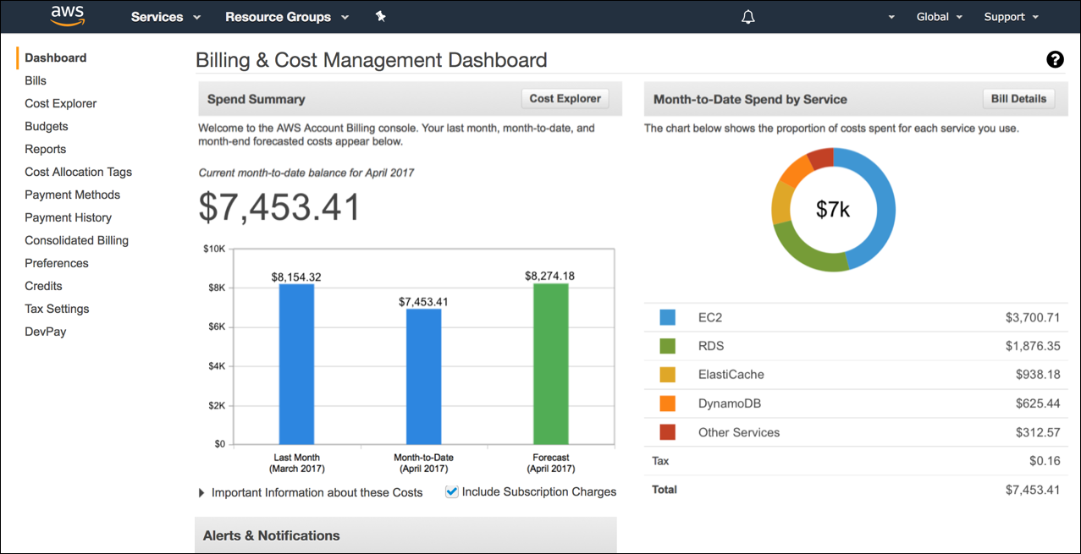
AWS billing dashboard
Notes:
The AWS billing dashboard enables you to view the status of your month-to-date AWS expenditure and pinpoint the services that account for the majority of your overall expenditure. You can also use the AWS Billing Dashboard to get a high-level understanding of how your costs are trending.
One of the graphs that is located on the dashboard is the Spend Summary, which shows you how much you spent last month, the cost of your AWS usage month-to-date, and a forecast of how much you are likely to spend this month. Another graph is the Month-to-Date Spend by Service graph, which shows the top services that you use most, and the proportion of your costs that are attributed to that service.

Slide 13
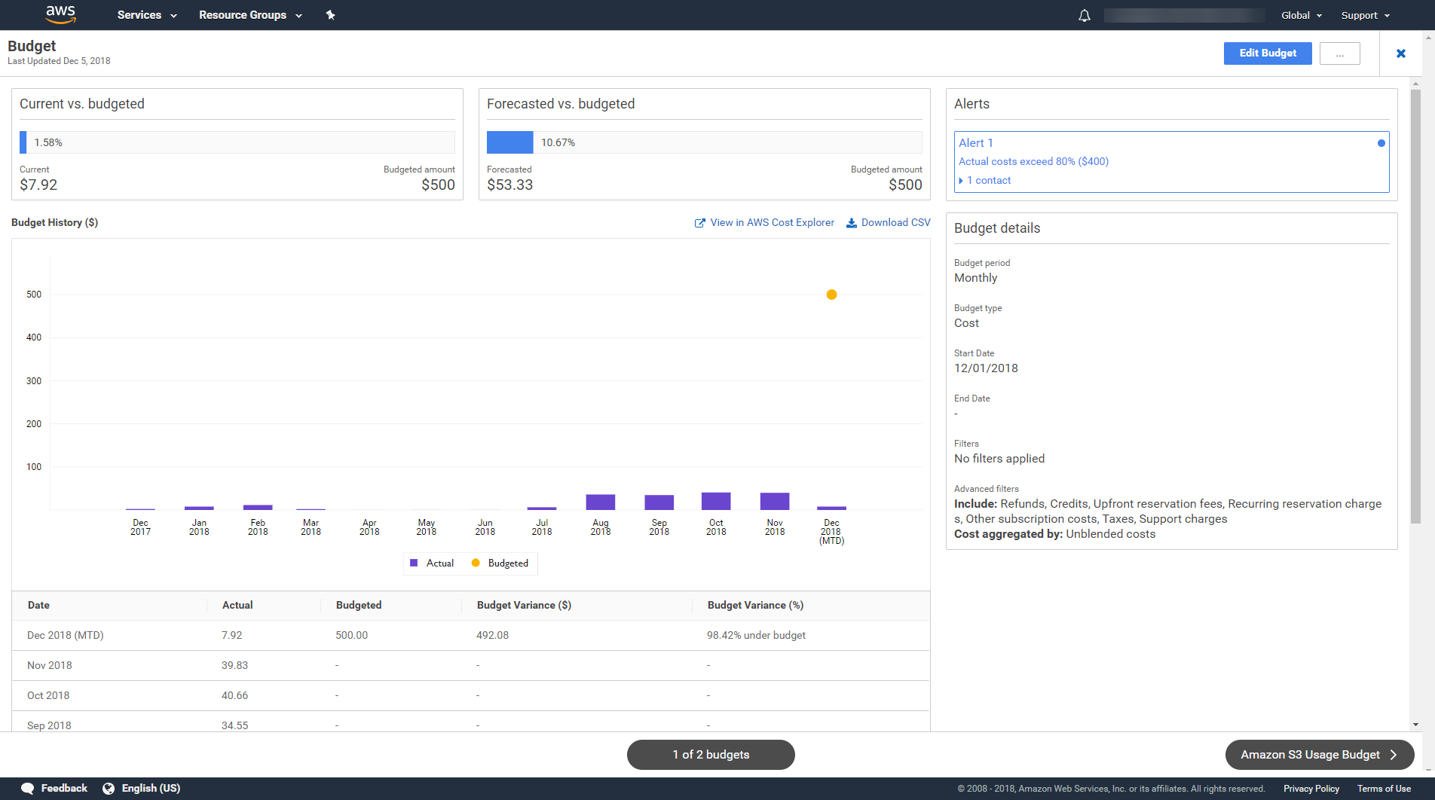
AWS Budgets
Notes:
AWS Budgets enables you to set custom budgets that alert you when costs or usage exceed (or are forecasted to exceed) your budgeted amount. AWS Budgets uses the cost visualization that is provided by Cost Explorer to show you the status of your budgets and to provide forecasts of your estimated costs. You can also use Budgets to create notifications if you go over your budgeted amounts, or when your estimated costs exceed your budgets. Budgets can be tracked at the monthly, quarterly, or yearly level, and you can customize the start and end dates. Budget alerts can be sent via email and/or through an Amazon Simple Notification Service (Amazon SNS) topic.
The example highlights the alert notification that was generated by AWS Budgets when a budget threshold was exceeded. In this case, the alert was triggered because actual costs exceeded 80 percent of the budget, and one person was notified as a result.

Slide 14

Amazon CloudWatch billing alarms
Generate an alert when estimated charges exceed a specified threshold
Enabled in the AWS Management Console
Must be created in the us-east-1 Region
Central storage for all billing metrics
Based on metrics that includes total and service-specific charges
Send email notifications through an Amazon Simple Notification Service (Amazon SNS) topic
Amazon CloudWatch billing alarm
Notes:
You can monitor your estimated AWS charges by using Amazon CloudWatch to generate an alert when your charges exceed a specified threshold. When you enable the monitoring of estimated charges for your AWS account, the estimated charges are calculated and sent several times daily to CloudWatch as metric data.
Billing metric data is stored in the US East (Northern Virginia) Region and represents worldwide charges. This data includes the estimated charges for every AWS service that you use, in addition to the estimated overall total of your AWS charges.
The alarm triggers when your account billing exceeds the threshold that you specify. It triggers only when the actual billing exceeds the threshold. It does not use projections that are based on your usage during the month.
If you create a billing alarm when your charges have already exceeded the threshold, the alarm immediately goes to the ALARM state.
Alarm notifications are sent to an email address via an Amazon Simple Notification Service (Amazon SNS) topic.

Slide 15
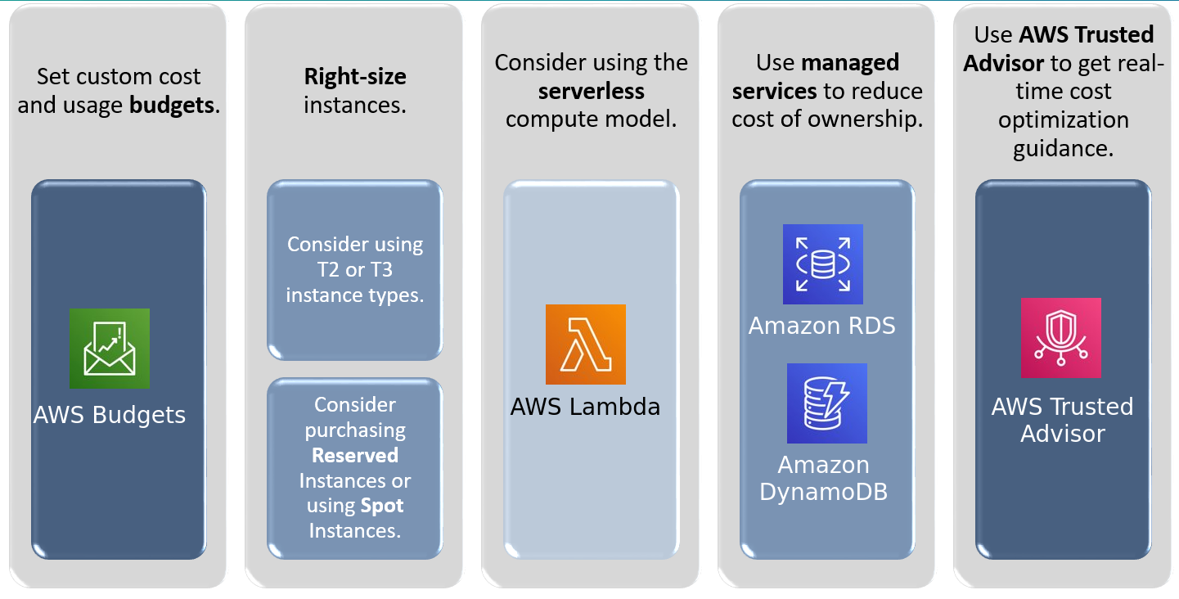
Designing for cost reduction
Notes:
You can monitor your estimated AWS charges by using Amazon CloudWatch to generate an alert when your charges exceed a specified threshold. When you enable the monitoring of estimated charges for your AWS account, the estimated charges are calculated and sent several times daily to CloudWatch as metric data.
Billing metric data is stored in the US East (Northern Virginia) Region and represents worldwide charges. This data includes the estimated charges for every AWS service that you use, in addition to the estimated overall total of your AWS charges.
The alarm triggers when your account billing exceeds the threshold that you specify. It triggers only when the actual billing exceeds the threshold. It does not use projections that are based on your usage during the month.
If you create a billing alarm when your charges have already exceeded the threshold, the alarm immediately goes to the ALARM state.
Alarm notifications are sent to an email address via an Amazon Simple Notification Service (Amazon SNS) topic.

Slide 16
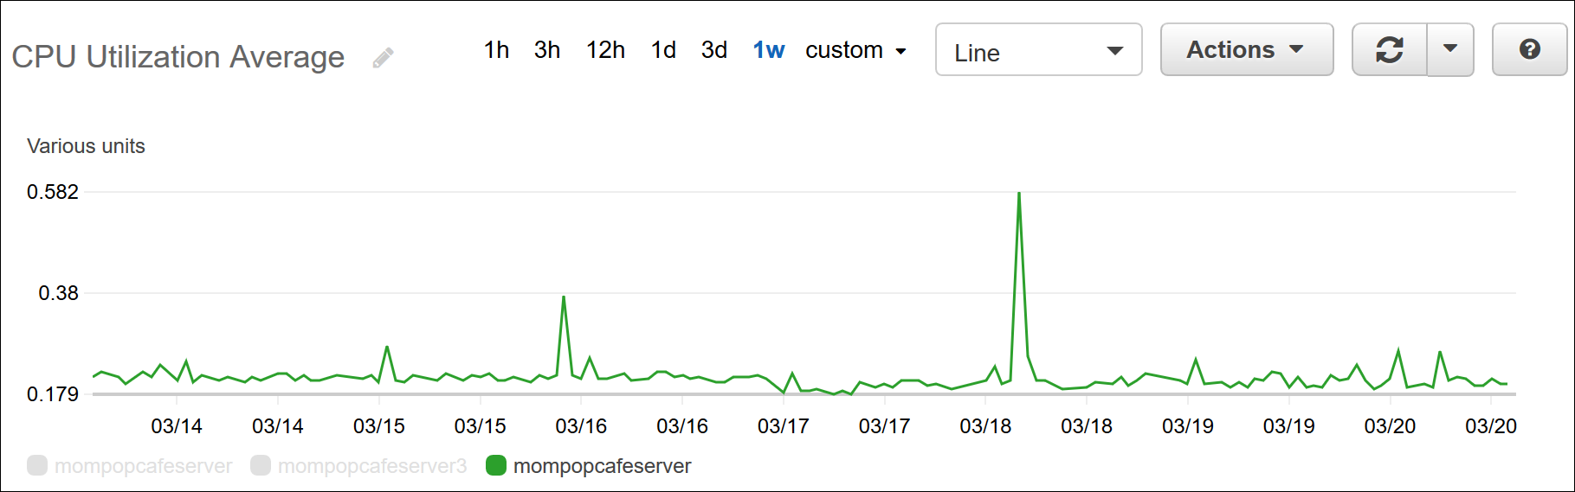
Finding and eliminating waste
Locate and eliminate waste by:
Using Amazon CloudWatch metrics to find long-running idle instances.
Sometimes, unneeded resources are kept running.
Using AWS Cost Explorer to find the costs associated with entire projects or initiatives.
Notes:
Another effective cost-reduction technique is to find and eliminate waste. For example, the ease of spinning up resources can sometimes lead to situations where unneeded resources are kept running. You can use Amazon CloudWatch metrics and CloudWatch alarms to find those long-running idle instances and shut them down. A CloudWatch utilization graph, such as the one that is shown, can help identify instances that are idle or rarely used.
You can also use AWS Cost Explorer to find the costs that are associated with entire projects or initiatives. AWS Cost Explorer can help you identify the most costly projects, and prioritize which projects should be examined first for cost-reduction opportunities.

Slide 17



Using a stopinator script
Use a stopinator script:
Turn on and turn off selected AWS resources
Is a best practice to reduce cost
For instance: https://dev.to/aws/simple-ec2-stopinator-in-lambda-5goj
stopinator stop [tags]
Instances
Amazon RDS
stopinator start [tags]
Notes:
Writing and using a stopinator script is a technique for automating the shutdown of instances. A stopinator is a generic term for any script or application written against the AWS platform that looks for and stops unused instances.
These scripts are typically set up to run during the evenings and on weekends. Employing a stopinator can result in significant cost savings to an organization, thus freeing up your cloud computing budget for new projects. It is also a useful dual function utility script because it is typically designed to allow you to start resources when you need them. For example, at the beginning of the workday.

Slide 18
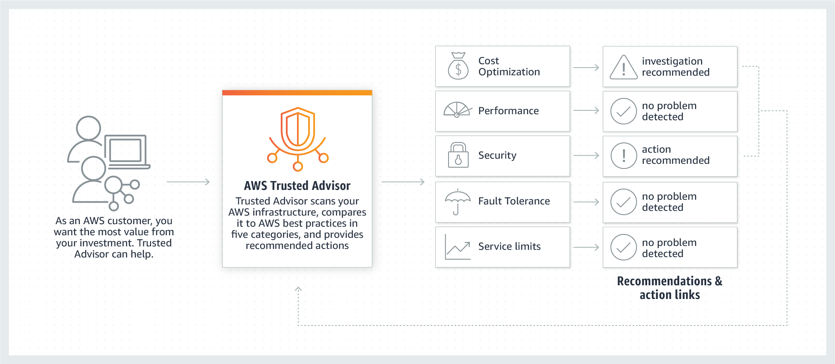
What is AWS Trusted Advisor?
Notes:
AWS Trusted Advisor is an online resource to help you reduce cost, increase performance, and improve security by optimizing your AWS environment. Trusted Advisor scans your AWS environment and compares it to more than 50 AWS best practices in five categories, and provides recommended actions. Recommendations include links to take direct action. Its real-time guidance helps you provision your resources according to AWS best practices.

Slide 19

AWS Trusted Advisor features
AWS Trusted Advisor features:
Sample cost optimization checks –
Idle resources (Amazon EC2 instances, Amazon RDS instances)
Underused load balancers and volumes
Unused Elastic IP addresses
Use cost-optimization checks to achieve a base level of cost savings
Core checks and recommendations available to all customers
Additional checks and recommendations available with Business or Enterprise support plans
AWS Trusted Advisor
Notes:
You can use AWS Trusted Advisor to identify idle resources, such as Amazon EC2 instances, underused load balancers and volumes, and unused Elastic IP addresses. Trusted Advisor is also an essential tool for cost optimization, and it provides checks and recommendations to allow you to achieve cost savings.
AWS Trusted Advisor offers high-level support plans—Business and Enterprise—which provide additional checks and recommendations.
For more information on AWS Trusted Advisor: https://aws.amazon.com/premiumsupport/trustedadvisor/

Slide 20
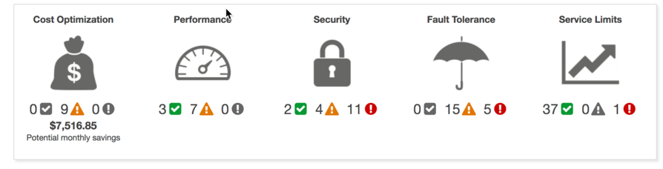
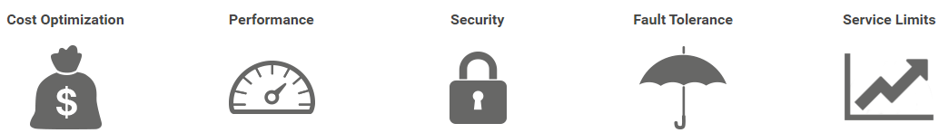

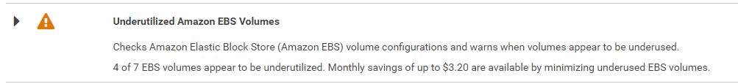
AWS Trusted Advisor recommendation categories
Checks Amazon Elastic Block Store (Amazon EBS) volume configurations and warns when volumes appear to be underused.
4 of 7 EBS volumes appear to be underutilized. Monthly savings of up to $1530.20 are available by minimizing underused EBS volumes.
Notes:
AWS Trusted Advisor analyzes your AWS environment and provides recommendations for best practices in five categories:
Cost optimization – Advice on how you can save money by eliminating unused and idle resources, or making commitments to reserved capacity.
Performance – Advice on how to improve the performance of your services by checking your service limits, ensuring you take advantage of provisioned throughput, and monitoring for overutilized instances.
Security – Advice on how to improve the security of your applications by closing gaps, enabling various AWS security features, and examining your permissions.
Fault tolerance – Advice on how to increase the availability and redundancy of your AWS applications by taking advantage of automatic scaling, health checks, Multi-AZ deployment, and backup capabilities.
Service limits – Advice on the services whose usage exceeds 80 percent of their service limit.
For information on best practices for Trusted Advisor: https://aws.amazon.com/premiumsupport/trustedadvisor/best-practices/

Slide 21


Extra leermaterialen & labs
Make Cost-Optimized Decisions on AWS (90min)
Managing Microsoft Azure Subscriptions (180min)

